Slide 1
Transition-Metal Hydrides
Stevens, R. C. et al. J. Am. Chem. Soc. 1989, 111, 3472-3473.

Slide 2
Our First Paper from the BNL-USC Collaboration
Olsen, J.P. et al., J. Am. Chem. Soc. 1974, 96, 6621-6624.
Notes:
Our first paper, published in JACS in 1974. Esd’s on bond distances ca. 0.004 Å! Note that the figure is actually that of HW₂(CO)₁₀⁻

Slide 3
‘Classical’ Hydrides: H Coordination Modes
Notes:
IrH₅[P(i-Pr)₃]₂ – Saeed Khan
[Ph₄P]⁺[W₂H(CO)₁₀]⁻ – Don Hart
Re₂H₈(PEt₂Ph)₄ – Ray Teller
Ni₄H₃(C₅H₅)₄ – Don Hart and Don Tipton
[(Ph₃P)₂N]⁺[Co₆H(CO)₁₅]⁻ – Don Hart, Ray Teller, and C.-Y. Wei

Slide 4
[Pt₂H₂Ph(PEt₃)₄]⁺[BPh₄]⁻
Neutron Structure at 13 K
Solution Equilibrium
Cleavage trans to Hydride
Pt₁…Pt₂ | 3.05(1) Å
∠ Pt₁–H_{b}– Pt₂ | 128(2) °
Albinati, A. et al., Inorg. Chim. Acta 1997, 265, 255-265.
Notes:
Neutron structure carried out with John Ricci and Wim Klooster.

Slide 5
Bis-(η⁵-pentamethylcyclopentadienyl)dicobalt?
Schneider, J. J. et al., Angew. Chem., Int. Ed. Engl. 1991, 30, 1124-1126.

Slide 6
Neutron Diffraction Study Proves the Compound Is {(η⁵-C₅Me₅)Co}₂(μ-H)₃
Paramagnetic!
Lutz, F. et al., Inorg. Chem. 1996, 35, 2698-2700.
Notes:
Neutron structure carried out with Frank Lutz, Tobias Metzinthin, and Roy Lu.

Slide 7
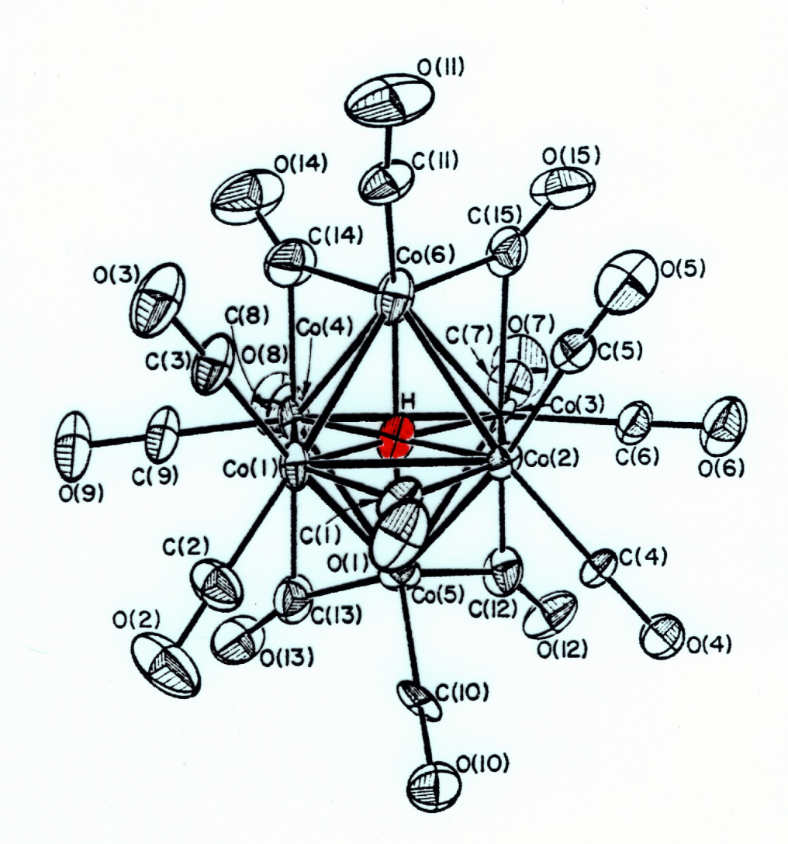
Interstitial Hydride in [Co₆H(CO)₁₅]⁻
Hart, D. W. et al., Angew. Chem., Int. Ed. Engl. 1979, 18, 80-81.
Notes:
Structure of the [Co₆H(CO)₁₅]⁻ anion, which crystallized as its PPN⁺ salt. The interstitial hydride lies at the center of the Co₆ octahedral cluster. This was our first interstitial hydride structure, with neutron work carried out by Don Hart with Ray Teller and C.-Y. Wei. In addition to five-coordinate [Rh₁₃H₂(CO)₂₄]³⁻, the Bau group subsequently determined the structures of tetrahedral interstitial hydrides to complete the series.

Slide 8
Canada Postmark – Dated June 6-8, 1989 FeH6 Cluster in FeH₆Mg₄Br_{3.5}Cl_{0.5}(C₄H₈O)₈
Bau, R. et al., Inorg. Chem. 1984, 23, 2823-2829.
Notes:
Sidney Gibbins’ (UBC) FeH₆ structure. The reverse situation from Co₆H. Mike Chiang and Doug Ho from Bob’s lab together with Tom Emge from our group at BNL.

